Slide 1
Learning with Hypergraphs: Clustering, Classification, and Embedding
A hypergraph is a graph in which an edge can connect more than two vertices [2]. In other words, an edge is a subset of vertices. In what follows, we shall unifiedly refer to the usual undirected or directed graphs as simple graphs.

Slide 2
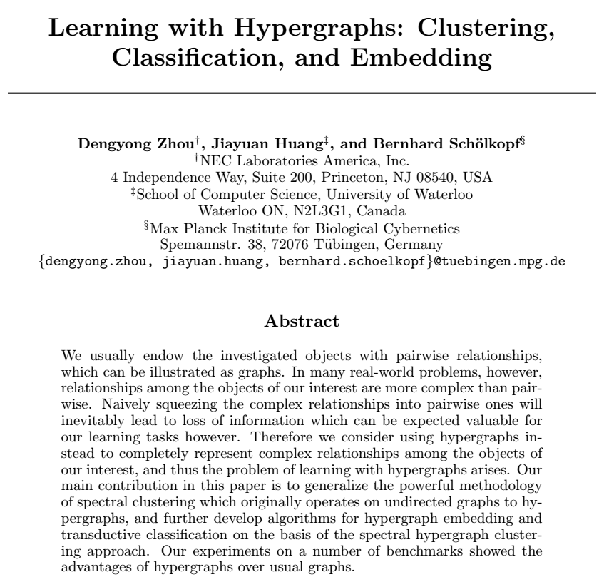

Slide 3
The first task we addressed is to embed the animals in the zoo dataset into Euclidean space. This dataset contains 100 animals with 17 attributes. The attributes include hair, feathers, eggs, milk, legs, tail, etc. The animals have been manually classified into 7 different categories. We embedded those animals into Euclidean space by using the eigenvectors of the hypergraph Laplacian associated with the smallest eigenvalues (Figure 2). For the animals having the same attributes, we randomly chose one as their representative to put in the figures. It is apparent that those animals are well separated in their Euclidean representations.

Slide 4
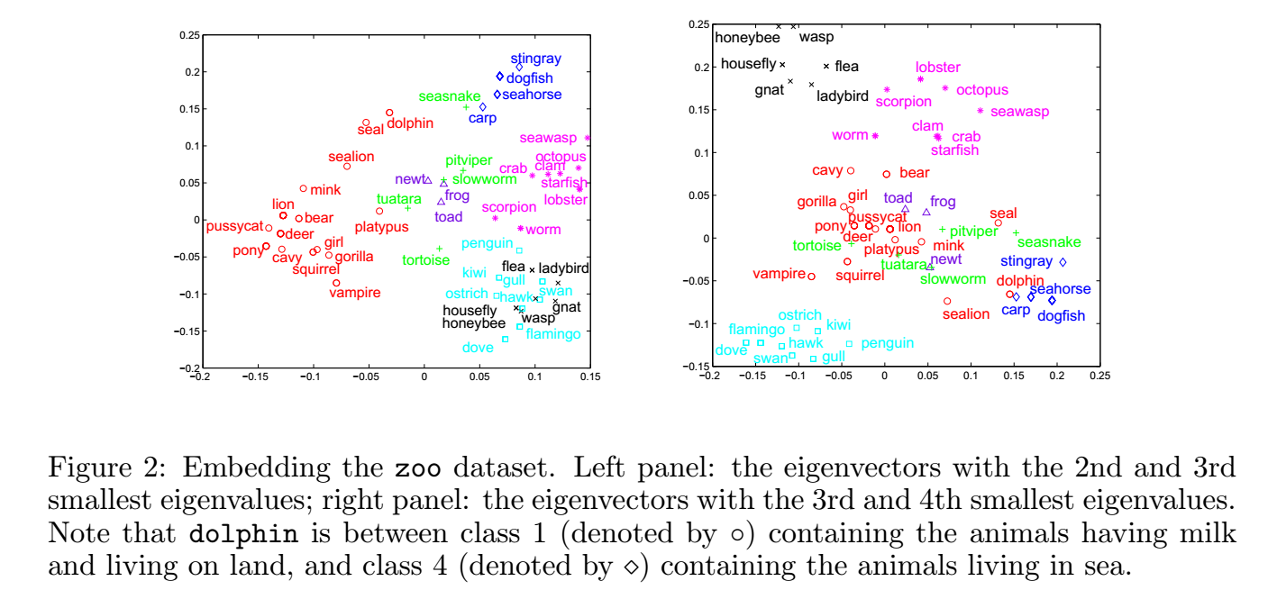

Slide 5
Comments
Early paper from 2005
This is helpful in clustering related classes based on their attributes: This dataset contains 100 animals with 17 attributes. The attributes include hair, feathers, eggs, milk, legs, tail, etc.
We can use hypergraph in the same way to cluster different related objects

Slide 6
A reductive approach to hypergraph clustering: An application to image segmentation
To the best of our knowledge, the first attempt for representing visual objects using hypergraphs dates back to Wong et al. In [50], the authors defined a framework for 3D object recognition. They used a 3D object model based on a hypergraph representation

Slide 7
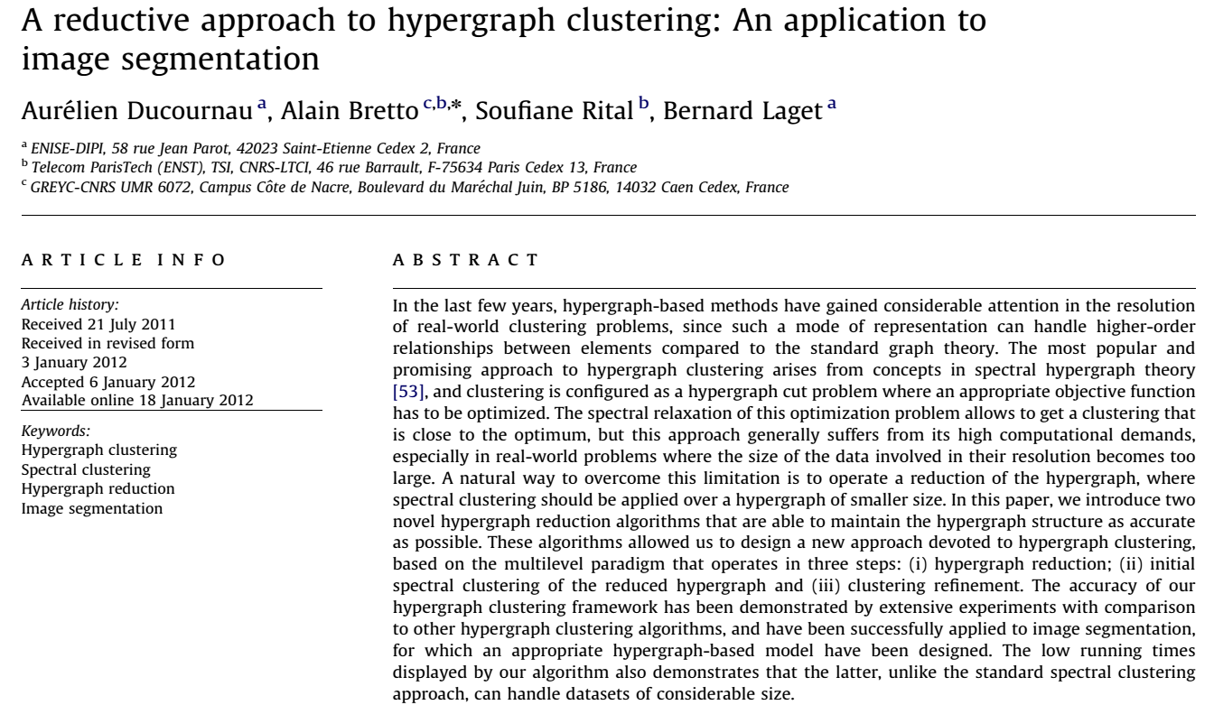

Slide 8
Bretto et al. introduced a hypergraph model for image representation by defining a new Image Neighborhood Hypergraph (INH). The INH model have then been exploited to successfully solve the problem of image segmentation by finding intersecting families to detect grayscale homogeneous regions
In this paper, the INH model serves as a basis for image data representation
Since Chung’s [15] definition of the Laplacian matrix for k-uniform hypergraphs, there have been several attempts to develop matrix representations of hypergraphs [35,52]. These hypergraph representations have found widespread applications in categorical data analysis

Slide 9
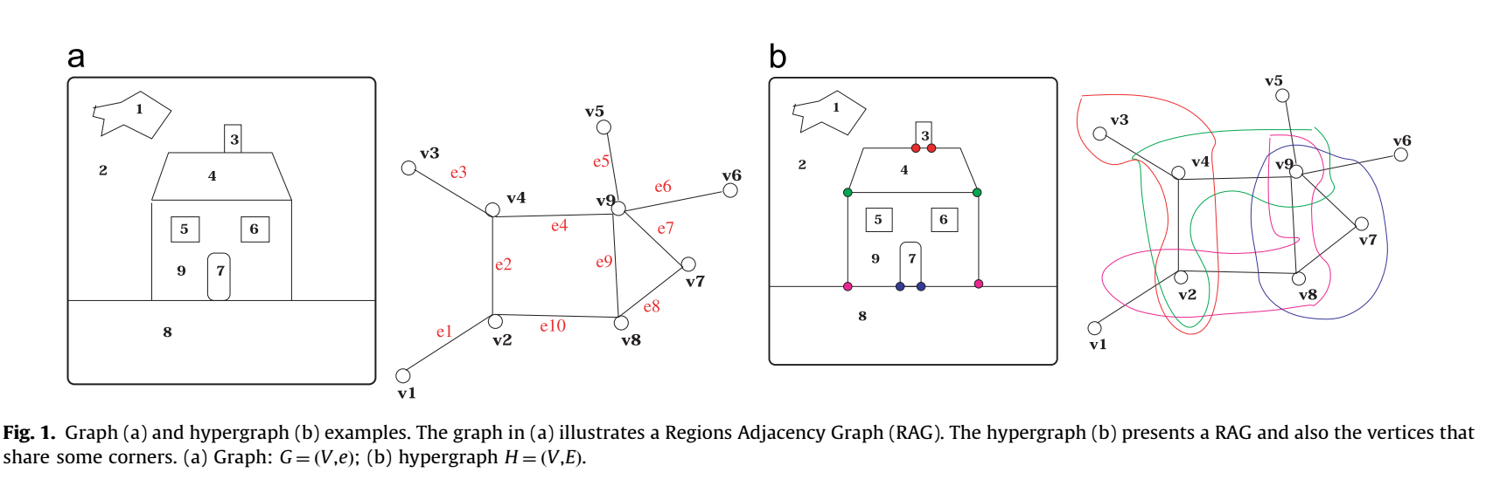

Slide 10
Comments
Hypergraph can also be used to represent RAG with richer information like shared corner
We can represent hypergraph with a matrix: Since Chung’s [15] definition of the Laplacian matrix for k-uniform hypergraphs, there have been several attempts to develop matrix representations of hypergraphs

Slide 11
Matching of hypergraphs—algorithms, applications, and experiments in: Applied Pattern Recognition, Studies in Computational Intelligence

Slide 12
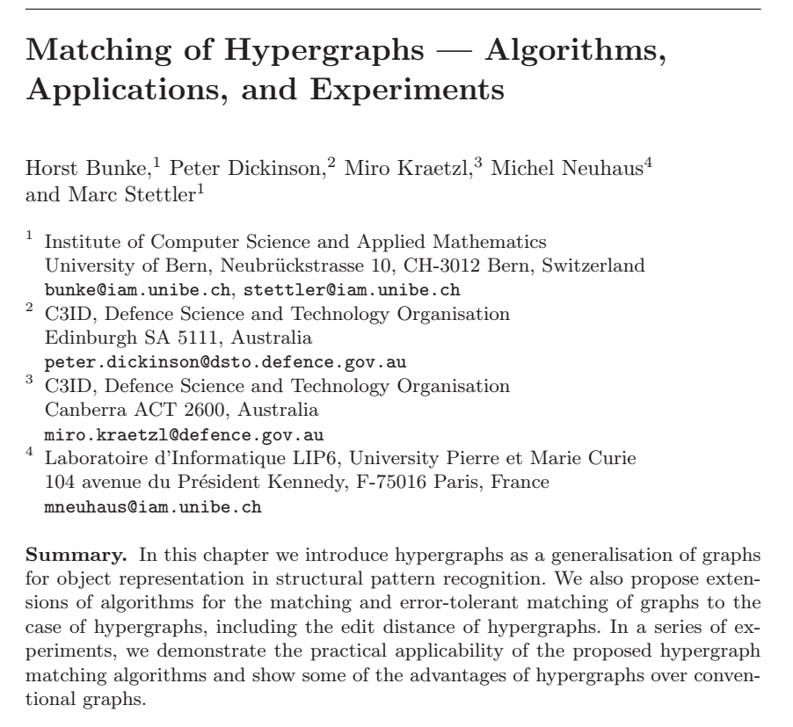

Slide 13
In pattern recognition and computer vision, region adjacency graph (rag) is a popular data structure to formally represent the contents of an image after it has been segmented into homogeneous regions. In a rag nodes represent image regions and edges between nodes indicate whether two regions are adjacent to each other or not.
For certain applications it may be interesting to know whether three (or more) regions meet at a common corner in the image. Such a relation among three (or more) regions can’t be directly represented in a normal graph.

Slide 14
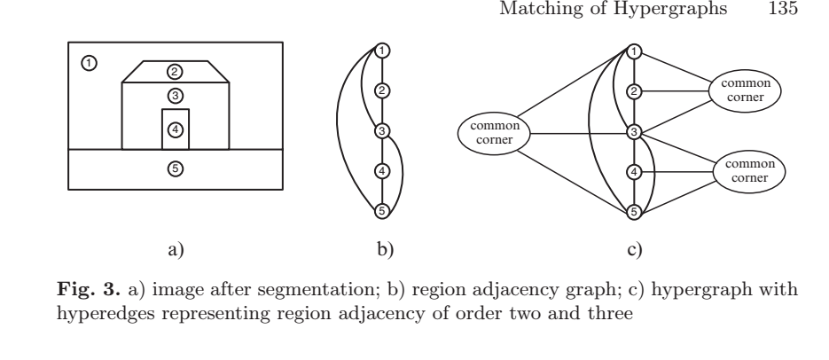

Slide 15
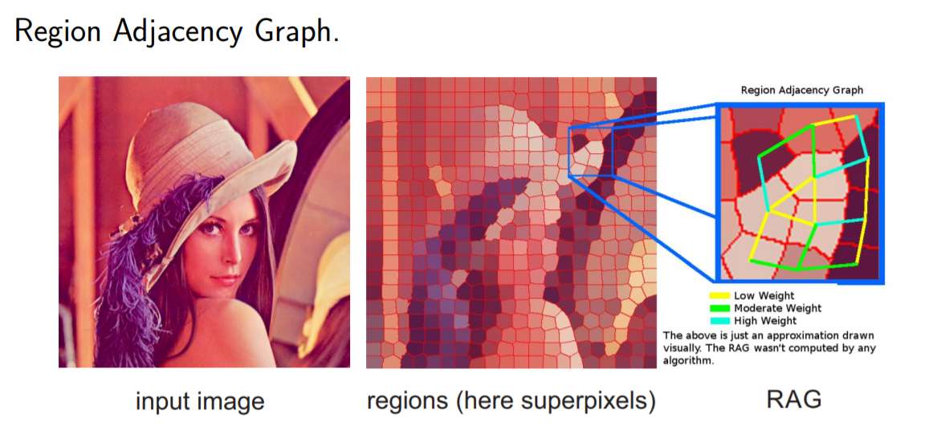

Slide 16
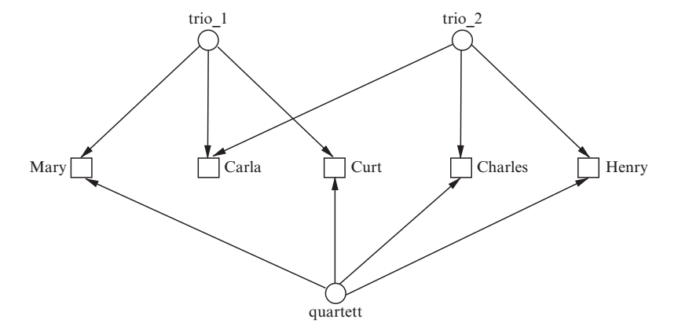
Example 2.3: This example involves a social network that represents relationships among musicians. Fig. 5 shows a hypergraph where each node represents a person and hyperedges indicate subgroups of persons who perform together in a trio or in a quartet. Such relations can’t be directly modeled in a normal graph.
Beach boat house.
We shouldn’t draw boat unless there is a beach in front of the house
However, house can be with other “bands” such as house tree bicycle

Slide 17
Comments
The example of people performing in a band is very interesting because we can think of objects in a sketch as people in a band too.

Slide 18
Similarity learning for graph-based image representations

Slide 19
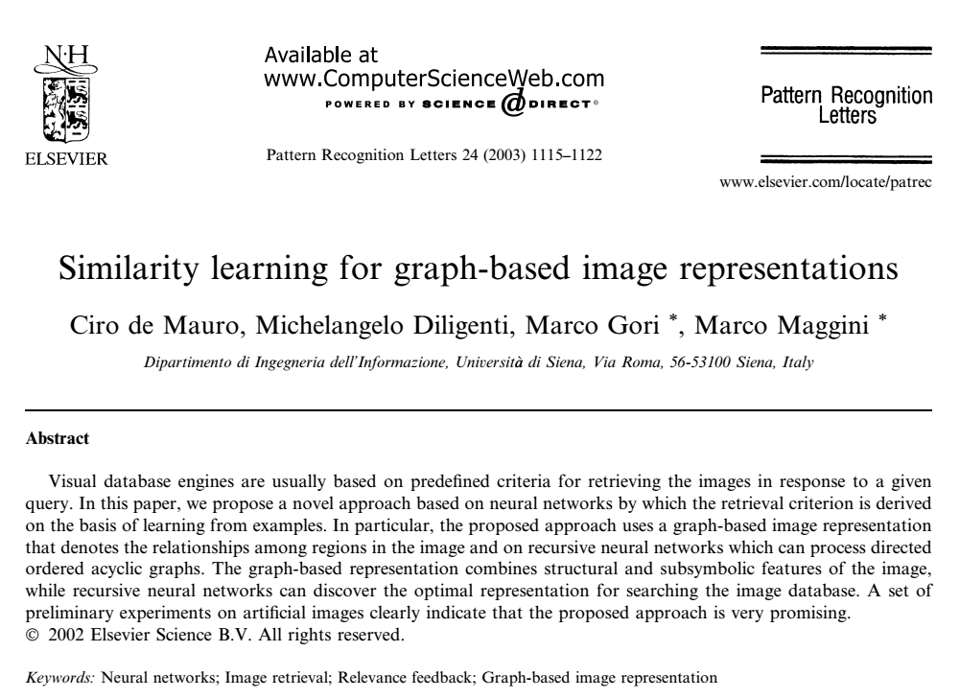

Slide 20
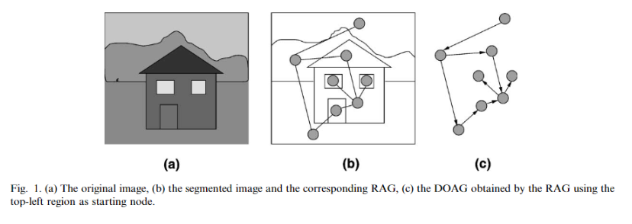
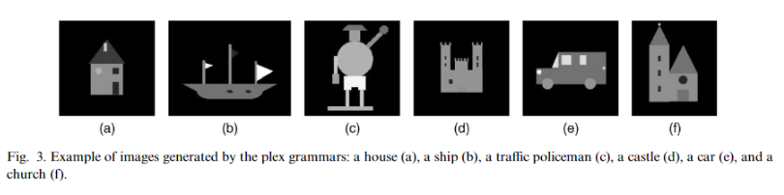

Slide 21
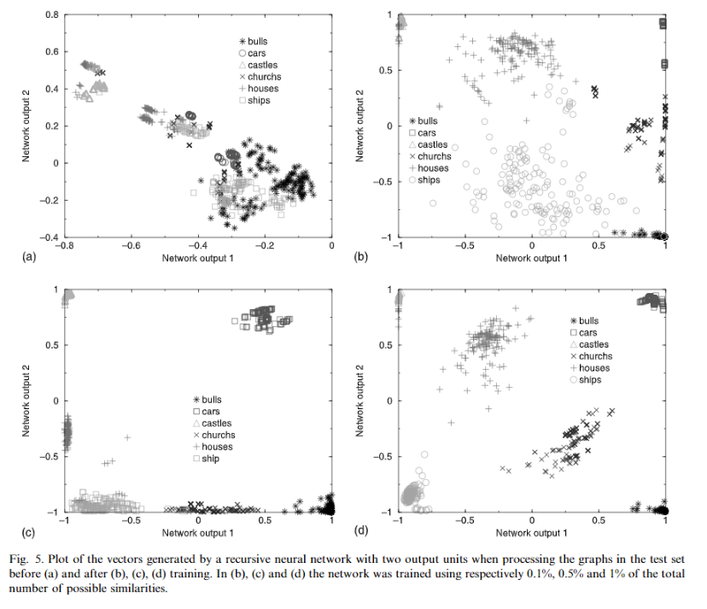

Slide 22
Comments
This is probably the most USEFUL paper I found. Basically, we can represent an image with different segments with a graph and then feed into a neural network to find similarities among them.

Slide 23
Artificial Neural Networks for Processing Graphs with Application to Image Understanding: A Survey
After the segmentation process, a graph that represents the arrangement of the obtained regions can be extracted. In such graph, the geometrical and visual properties of each region is collected into the label of the related node. Instead, the edges, which link nodes of the structure, are exploited in order to describe the topological arrangement of the extracted regions.

Slide 24
